Slide 1
Using EMI Methods to Map Soil Characteristics
Presented by Ansley J. Brown – “A.J.”
11 July 2023
Notes:
SPEAK SLOWLY!!!!!!!!!!!!

Slide 2


About Me
Agricultural Data Scientist for CSU Ag Water Quality Program (AWQP)
Certified Crop Advisor (CCA)
My areas of research are
Data science in water resources
Irrigation science
Soil salinity
Environmental sensing technology
Grew up on a farm in Rocky Ford, CO
Contact Me: Ansley.Brown@colostate.edu
Scan here to visit AWQP website!

Slide 3

Overview
What is Electromagnetic Induction?
Principles of EMI Instruments
Properties Measured by all EMI Devices
Factors that Affect Apparent Soil Electrical Conductivity
Introduction to the EM38-MK2
Calibration
Survey Setup
Data Downloading
Notes:
SPEAK SLOWLY!!!!!!!!!!!!

Slide 4
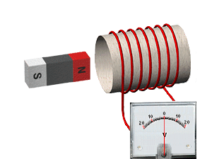
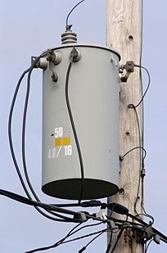
What is Electromagnetic Induction?
EMI is the production of an electric current by changing the magnetic field enclosed by an electrical circuit.
Magnetic fields can create an electromotive force (EMF) which drives an electric current.
EMI is used for the generation of most of the electricity that is produced in the world today, such as in any electric generator.
It is also used in electrical transformers, which increase or decrease the voltage of an alternating current (A/C) power supply.
For us, EMI is used to measure bulk apparent soil conductivity (EC_{a}) and Magnetic Susceptibility.
Notes:
SPEAK SLOWLY!!!!!!!!!!!!

Slide 5

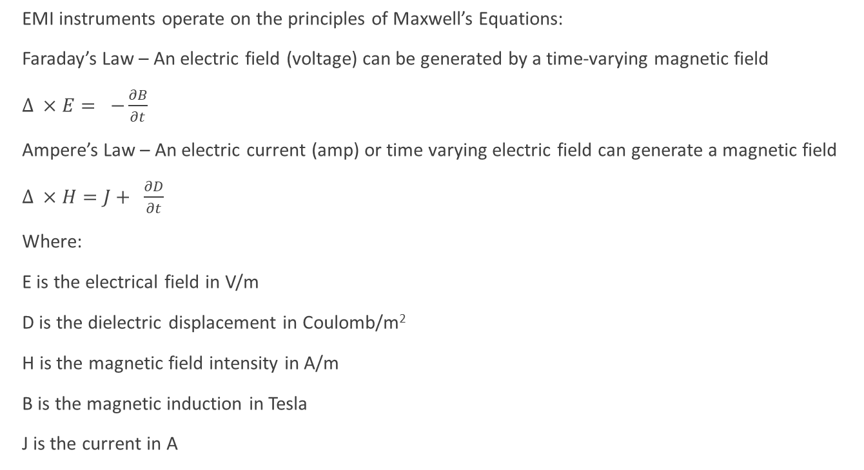
Principles of EMI Measurements
EMI instruments operate on the principles of Maxwell’s Equations:
Faraday’s Law – An electric field (voltage) can be generated by a time-varying magnetic field
$Δ ×E= −\frac{∂B}{∂t}$
Ampere’s Law – An electric current (amp) or time varying electric field can generate a magnetic field
$Δ ×H=J+ \frac{∂D}{∂t}$
Where:
E is the electrical field in V/m
D is the dielectric displacement in Coulomb/m²
H is the magnetic field intensity in A/m
B is the magnetic induction in Tesla
J is the current in A
Notes:
SPEAK SLOWLY!!!!!!!!!!!!

Slide 6
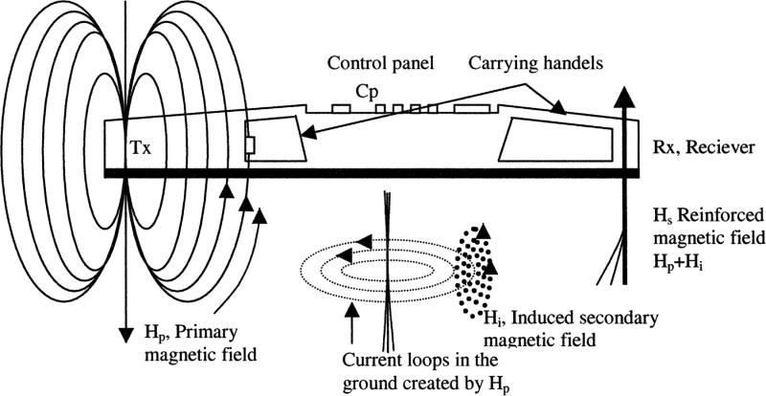
(Corwin, 2012)
The primary waves induce secondary magnetic fields which are then measured by the receiver coils
Notes:
SPEAK SLOWLY!!!!!!!!!!!!
A transmitt er coil located at one
end of the EMI instrument induces circular eddy-current loops
in the soil, with the magnitude of these loops directly proportional
to the electrical conductivity in the vicinity of that loop
(Fig. 9). Each current loop generates a secondary electromagnetic
fi eld that is proportional to the value of the current fl owing
within the loop. A fraction of the secondary induced electromagnetic
fi eld from each loop is intercepted by the receiver
coil of the instrument, and the sum of these signals is amplifi ed
and formed into an output voltage, which is related to a depthweighted
ECa. The amplitude and phase of the secondary fi eld
will diff er from those of the primary fi eld as a result of soil properties
(e.g., clay content, water content, salinity), spacing of the
coils and their orientation, frequency, and distance from the soil
surface (Hendrickx and Kachanoski, 2002).

Slide 7
Primary EM Field Response
Transmitter Coil Wave
Secondary EM Field Response (Quad-Phase)
Receiver Coil Waves
Secondary EM Field Response (In-Phase)
Amplitude
Time
Differences between the transmitted and received waves reveal the presence of the conductor and provide information on its geometery and electrical properties:
Quad-phase (Q/P): Quadrature Component = Conducitivity (mS/m)
In-phase (I/P): In-phase Component = Magnetic Susceptibility (ppt)
Notes:
SPEAK SLOWLY!!!!!!!!!!!!
A transmitt er coil located at one
end of the EMI instrument induces circular eddy-current loops
in the soil, with the magnitude of these loops directly proportional
to the electrical conductivity in the vicinity of that loop
(Fig. 9). Each current loop generates a secondary electromagnetic
fi eld that is proportional to the value of the current fl owing
within the loop. A fraction of the secondary induced electromagnetic
fi eld from each loop is intercepted by the receiver
coil of the instrument, and the sum of these signals is amplifi ed
and formed into an output voltage, which is related to a depthweighted
ECa. The amplitude and phase of the secondary fi eld
will diff er from those of the primary fi eld as a result of soil properties
(e.g., clay content, water content, salinity), spacing of the
coils and their orientation, frequency, and distance from the soil
surface (Hendrickx and Kachanoski, 2002).

Slide 8
Factors that Affect Soil Conductivity
Conductivity (EC_{a}) ≠ Salinity (EC_{e})
Conductivity is affected by:
Water Content
Soil Texture
Soil Salinity
Soil Organic Matter
Depth to Claypans
Cation Exchange Capacity (CEC)
Conductive Ions
3 pathways:
Solid-liquid
Liquid
Solid
Schematic illustrating the three conductance pathways
for the apparent soil electrical conductivity (ECa) measurement:
solid–liquid (Pathway 1), liquid (Pathway 2), and solid (Pathway 3)
(Corwin et. al. 2017)
Notes:
SPEAK SLOWLY!!!!!!!!!!!!

Slide 9
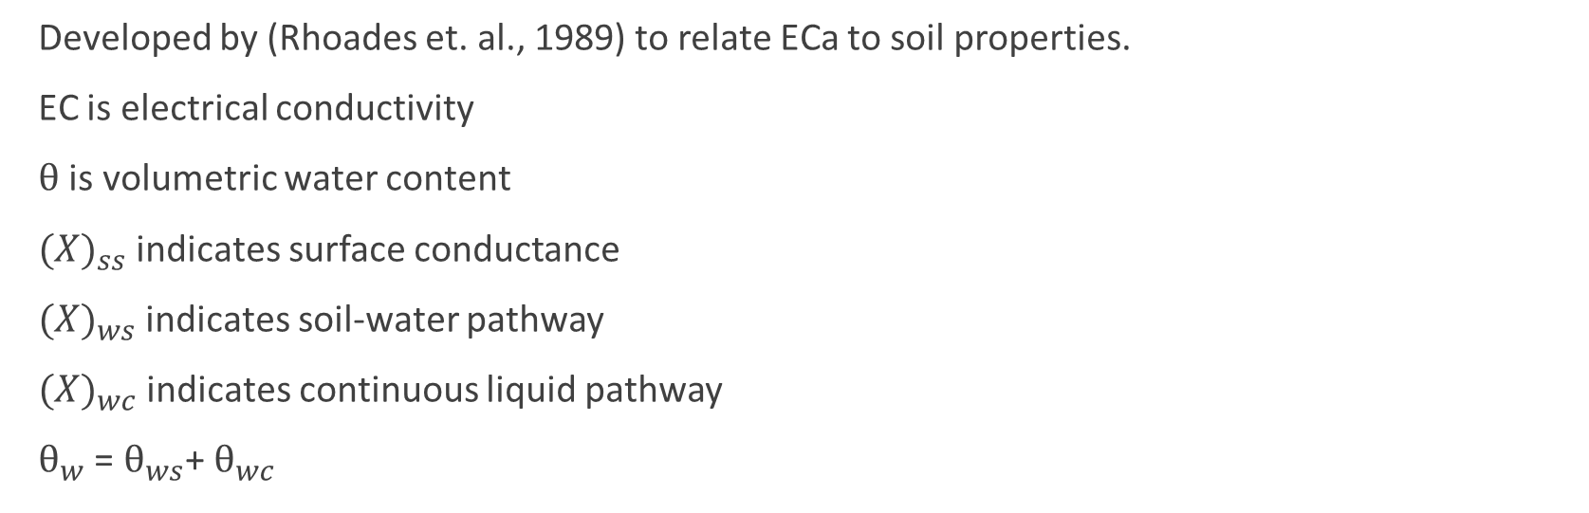
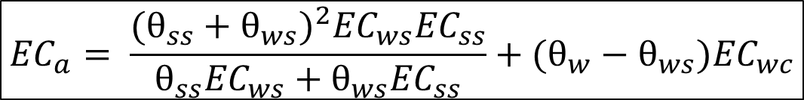
Dual Pathway Parallel Conductance (DPPC)
$${EC}_{a}= \frac{{(θ_{ss}+θ_{ws})}^{2}{EC}_{ws}{EC}_{ss}}{θ_{ss}{EC}_{ws}+θ_{ws}{EC}_{ss}}+(θ_{w}−θ_{ws}){EC}_{wc}$$
Developed by (Rhoades et. al., 1989) to relate ECa to soil properties.
EC is electrical conductivity
$θ$ is volumetric water content
${(X)}_{ss}$ indicates surface conductance
${(X)}_{ws}$ indicates soil-water pathway
${(X)}_{wc}$ indicates continuous liquid pathway
$θ_{w}$ = $θ_{ws}$+ $θ_{wc}$
Notes:
SPEAK SLOWLY!!!!!!!!!!!!

Slide 10
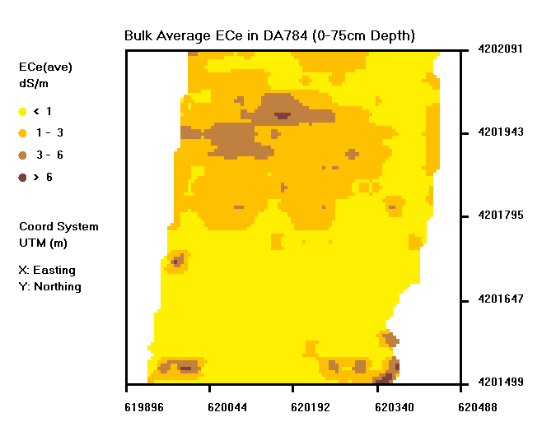
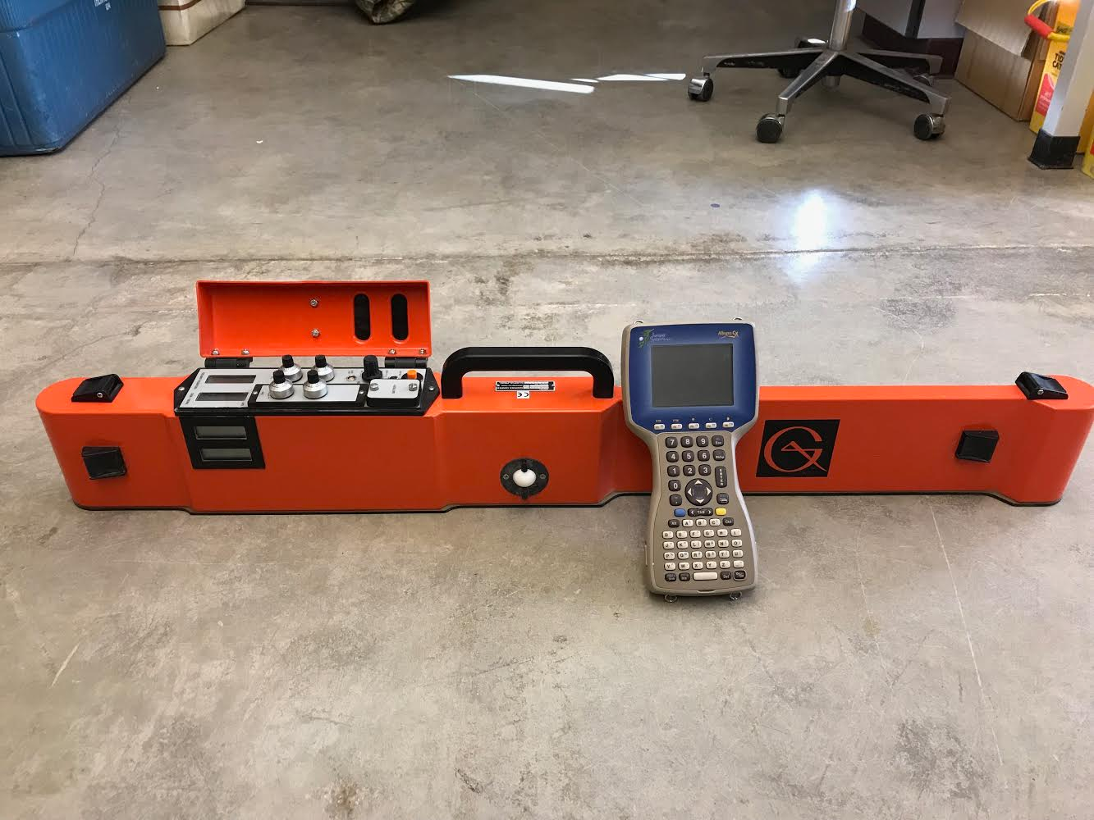
Introduction to the EM38-MK2
Measures Q/P and I/P and 2 different depths simultaneously
Integrates Bluetooth in to survey technology
Has a temperature correction feature
Can be used to generate large scale salinity maps with relative ease
Notes:
SPEAK SLOWLY!!!!!!!!!!!!

Slide 11
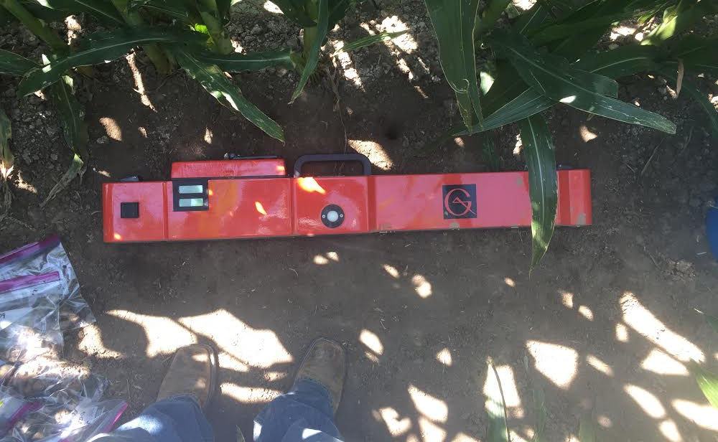
How to Control Depth of EM Measurements
Vertical Dipole Mode
Change coil separation distance
Change the dipole mode or rotate transmitter and receiver coils
Change frequencies of transmitter
Horizontal Dipole Mode
Notes:
SPEAK SLOWLY!!!!!!!!!!!!

Slide 12
Coil Schematic of the EM38-MK2 in Vertical Dipole Mode
1m Coil
0.5m Coil
Soil Surface
Tx
Control Panel
Rx 0.5m
Rx 1m
0.75m
1.5m
Notes:
SPEAK SLOWLY!!!!!!!!!!!!

Slide 13
EM38-MK2 Vertical Dipole Mode:
Rx₁ = H_{p} + H_{i} at 0.75m depth
Rx₂ = H_{p} + H_{i} at 1.5m depth
1m Coil
0.5m Coil
Soil Surface
Tx
Control Panel
Rx₁ 0.5m
Rx₂ 1m
0.75m
Induced Secondary Magnetic Fields, H_{i}
1.5m
Primary Electromagnetic Field, H_{p}
Current Loops Generated from Primary Field

Slide 14
Coil Schematic of the EM38-MK2 in Horizontal Dipole Mode
1m Coil
Soil Surface
0.5m Coil
Tx
Control Panel
Rx
Rx
0.375m
0.75m
Notes:
SPEAK SLOWLY!!!!!!!!!!!!

Slide 15
Calibrating the EM38-MK2
In-Phase Nulling
Instrument Zero or True Calibration
Final In-phase Nulling
Repeat steps 1-3 for each receiver coil
Notes:
SPEAK SLOWLY!!!!!!!!!!!!

Slide 16

I/P
1m
I/P
Q/P
Q/P
.5m
I/P Control Knobs
Q/P Control Knobs
1m Control Knobs
.5m Control Knobs
KEY =
Notes:
SPEAK SLOWLY!!!!!!!!!!!!

Slide 17
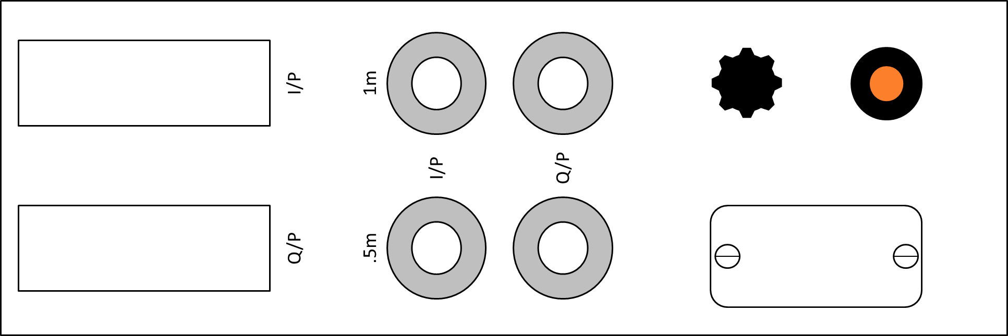
In-Phase Nulling
TURN UNTIL I/P IS ZERO
In order for the receiver coil to measure the signals generated from the eddy currents fount in the soil, the much larger, primary signal must be “nulled” by adjusting the In-Phase knobs on the EM38-mk2.
To null the EM38-MK2:
Place the instrument on the calibration stand in horizontal dipole mode so that the device is 1.5m above the ground surface
Turn the indicator knob to the “1m” setting
Unlock and turn the 1m I/P knob so that the I/P display reading is zero
Lock the knob again
000
Notes:
SPEAK SLOWLY!!!!!!!!!!!!

Slide 18
Instrument Zero (Q/P)
TURN UNTIL VERTICAL Q/P IS DOUBLE HORIZONTAL Q/P
In order to accurately measure conductivity of the soil, the EM38-MK2 must be calibrated in a way that is similar to the I/P setting so that the device only reads conductivity generated from the soil profile and not any interfering signals or objects.
To Zero the EM38-MK2:
Place the instrument on the calibration stand in horizontal dipole mode so that the device is 1.5m above the ground surface
Turn the indicator knob to the “1m” setting
Turn the 1m Q/P knob so that the Q/P display is reading an arbitrary, low number (e.g. 10)
Flip the device to vertical dipole mode and read the Q/P display
The vertical dipole Q/P reading should be double the value of the horizontal dipole Q/P reading. Adjust the horizontal Q/P reading until this is true.
Lock the knob once complete
010
I/P
020
Q/P
Notes:
SPEAK SLOWLY!!!!!!!!!!!!

Slide 19
Final In-Phase Nulling
TURN UNTIL I/P IS ZERO
The magnetic susceptibility of soils causes an additional signal to be picked up by the receiver coils when the EM38-MK2 is near to, or lying on the ground surface.
To avoid any bias caused by this:
Place the instrument on the ground in vertical dipole mode
Turn the indicator knob to the “1m” setting
Unlock and turn the 1m I/P knob so that the I/P display reading is zero
Lock the knob again
000
Notes:
SPEAK SLOWLY!!!!!!!!!!!!

Slide 20

REPEAT STEPS 1-3 WITH DEVICE IN .5m MODE
Notes:
SPEAK SLOWLY!!!!!!!!!!!!

Slide 21

Video of Calibration
Notes:
SPEAK SLOWLY!!!!!!!!!!!!

Slide 22
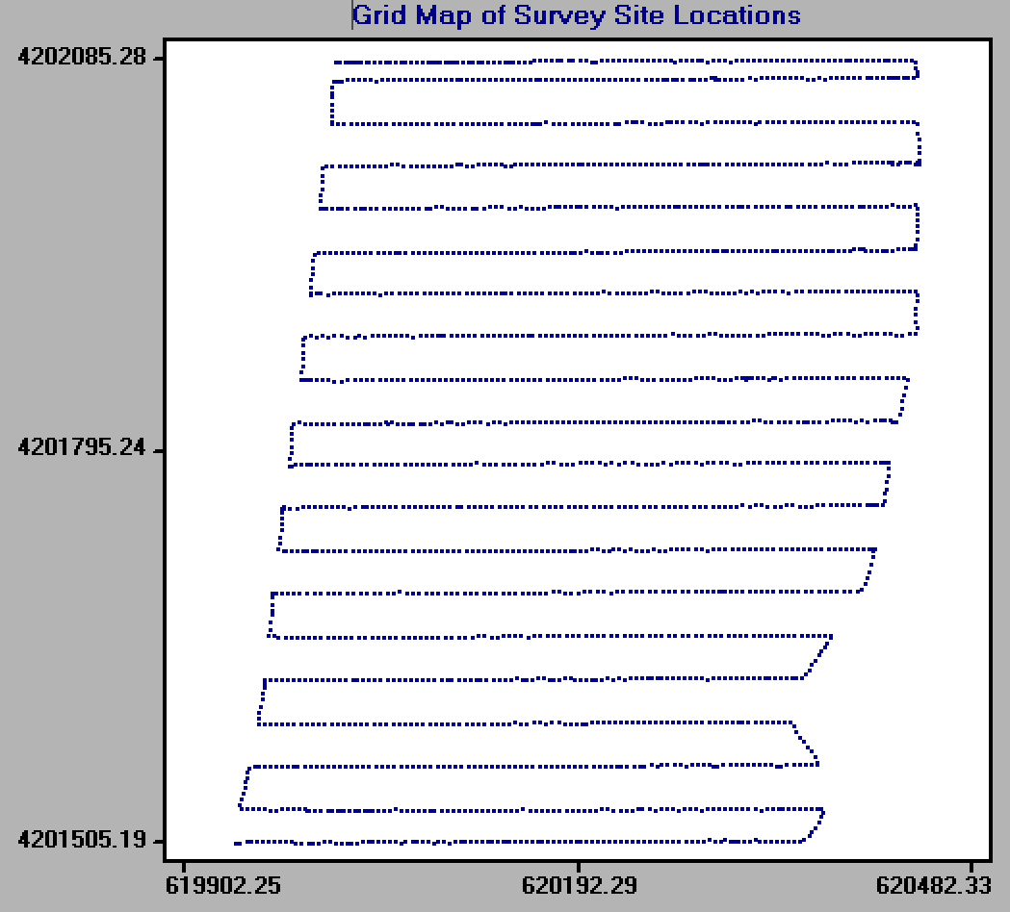
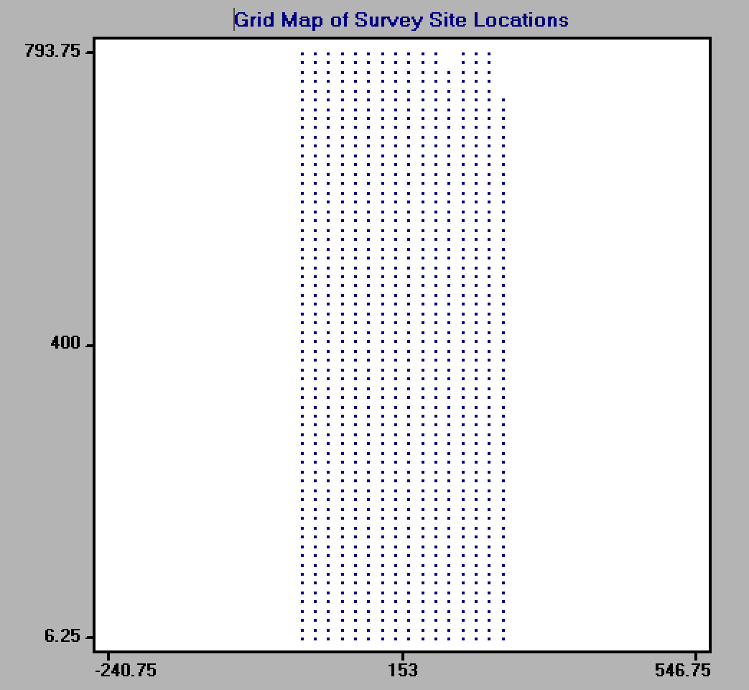
EM38-MK2 Survey Setup
Transect survey
Grid survey
Notes:
SPEAK SLOWLY!!!!!!!!!!!!

Slide 23
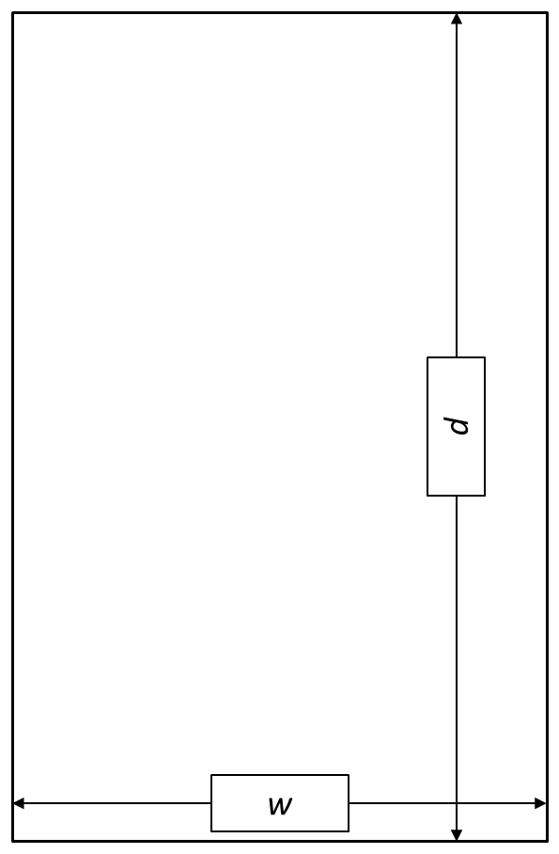
Rule of Thumb
SURVEY
FIELD
When performing a survey, edge bias is always a concern. To avoid edge bias:
The number of transects desired in a field is, n
EM38-MK2 should be kept 0.5*(w/n) from the width and 0.5*(d/n) from the length
The distance between transects should also be d/n
d is always the length parallel to the field furrows (as surveys should always run parallel to furrows to avoid compaction bias)
Programs like ESAP-RSSD can mask readings with edge bias through edge buffering algorithms
Notes:
SPEAK SLOWLY!!!!!!!!!!!!

Slide 24
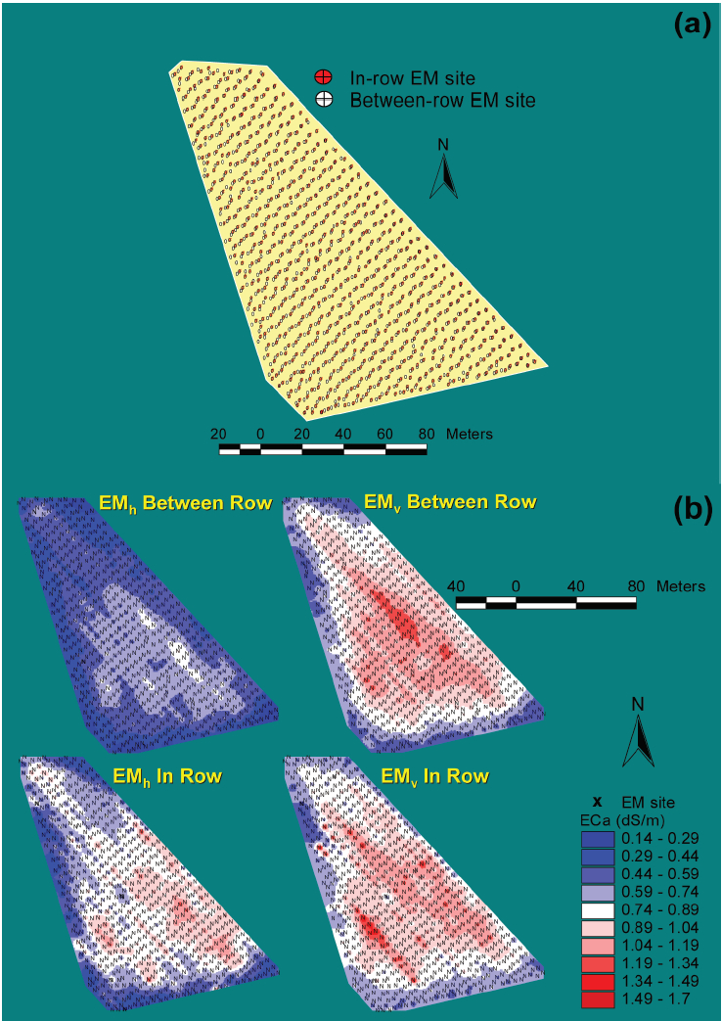

On-Row vs. In-Row Measurement
(Corwin, 2016)
Differences have been seen in measuring ECa in fields where bed furrows are used.
The important part is to remain consistent within field and between fields of comparison.
Sometimes both surveys are desired (i.e. drip irrigation system for vineyard or vegetables)
In Row
Between Row
Notes:
SPEAK SLOWLY!!!!!!!!!!!!

Slide 25
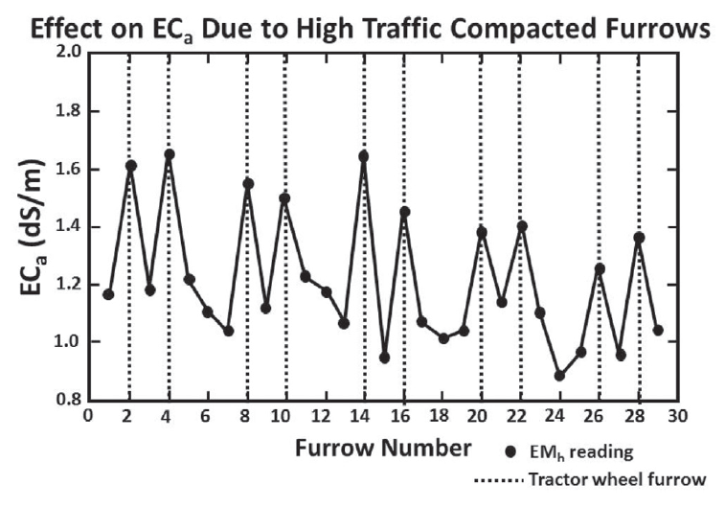
Other Important Considerations
Metal is a HUGE influencer of EM readings
Do not wear ANY metal during the survey
Be aware of any potential metal in the field (i.e. metal fences, vineyard trellises, buried metal objects, and underground metal pipe.)
Surface roughness
If part of the field is ploughed and the rest is smooth, then differences will be seen in Eca
Irrigation Management
If moisture distribution is uneven (vertically and laterally), expect to see differences in Eca
Field should be within 70% of field capacity to field capacity to ensure proper EM measurement (too wet, or to dry is bad)
Compaction
Soil compaction will significantly alter measured ECa.
Elevation
Non-farm lands tend to be uneven, and elevation surveys should also be performed
Temperature
The EM38-MK2 has a temperature correction factor, but older models are influenced by temperature
(Corwin and Lesch, 2005)
Notes:
SPEAK SLOWLY!!!!!!!!!!!!

Slide 26
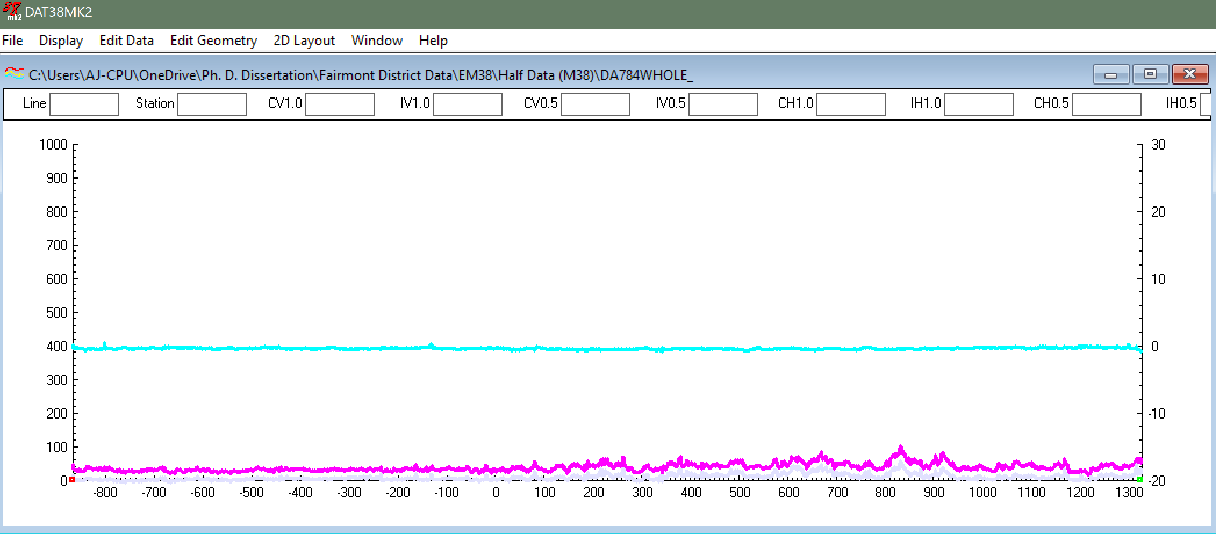
Downloading EM38-MK2 Data
To download survey data from the EM38-MK2 we must transfer the data from the handheld CPU to a desktop where we can process it in DAT38MK2.
This program takes raw (.N38) files and translates them into Profile(.M38) files, and finally into other usable formats such as .txt and .csv files
Notes:
SPEAK SLOWLY!!!!!!!!!!!!

Slide 27

Raw File to Profile File
Step 1:
Convert → Convert Raw (N38) Files into Profile (M38) Files
Step 2:
Designate input file location and name output file
Step 3:
Press Convert
Notes:
SPEAK SLOWLY!!!!!!!!!!!!

Slide 28

Profile File into .CSV File
Step 1:
File → Open Profile File
Step 2:
Open .M38 file previously saved
Step 3:
2D Layout → Create GPS based XYZ File
Step 4:
Adjust settings accordingly (Shown on next slide) and press Proceed
Notes:
SPEAK SLOWLY!!!!!!!!!!!!

Slide 29
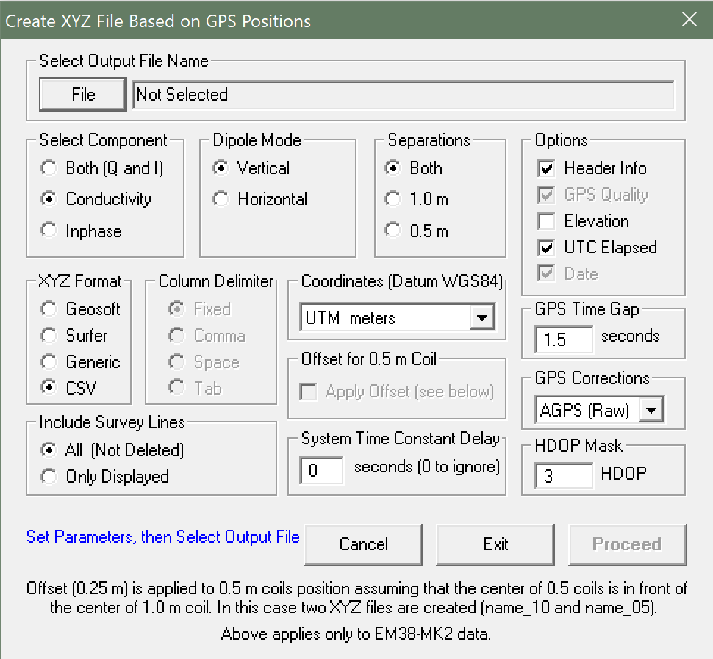
Designate input file (.M38)
Select Desired output
Select dipole mode that survey was carried in
Specify coordinate system
Specify output file format
Specify GPS corrections (for differential or RTK GPS systems)
Notes:
SPEAK SLOWLY!!!!!!!!!!!!

Slide 30
Data Conversion is Complete!
Output file is now ready for further use
This file is how the conversion of ECa to ECe is generated in Excel
This file will also serve as the input data for response surface sampling designs such as in the ESAP-RSSD program
Notes:
SPEAK SLOWLY!!!!!!!!!!!!

Slide 31
References
Catalano, Michael “Measuring Soil Conductivity with Geonics Limited Electromagnetic Geophysical Instrumentation” Global Workshop on Proximal Sensing. (2011). https://adamchukpa.mcgill.ca/gwpss/Presentations/GWPSS_2011_Catalano.pdf
Corwin, Dennis L., et al. "Laboratory and field measurements." ASCE Manual and Reports on Engineering Practice 71 (2012): 295-341.
Corwin, Dennis L., and Elia Scudiero. "Field-scale apparent soil electrical conductivity." Methods of soil analysismsaonline2016 (2016).
Corwin, Dennis L., and Kevin Yemoto. "Salinity: Electrical Conductivity and Total Dissolved Solids." Methods of Soil Analysis 2.1 (2017).
Rhoades, J. D., et al. "Soil electrical conductivity and soil salinity: New formulations and calibrations." Soil Science Society of America Journal 53.2 (1989): 433-439.

Slide 32



Acknowledgements & Sponsors
Timothy Gates, Allan Andales, Jose Chavez, Greg Butters, and Thomas Borch
Notes:
No slide numbers

Slide 33
Questions
Thank You

